Slide 1

Part 1: Quiz Maker
Alexander O’Dea and Connor Maxwell

Slide 2

Quiz Requirements
Have Python installed on PC
Download our provided file with testbank.txt from D2L
Run program and follow prompts (Input user ID as AXXXXX) X=Number
Select either 10/20 Questions to preferred extent
After quiz is comeplete, it will display score
Notes:
Turtle Module: Used for drawing the game grid and flashing tiles.
Random Module: choice() function from the random module is used to select a random tile to add to the pattern.
Time Module: sleep() function is used to create delays between tile flashes, enhancing the visual effect.

Slide 3
Part 2: The Games
Alexander O’Dea and Connor Maxwell

Slide 4

Game 1: Simon Memory Game
Game Setup:
Uses the turtle and freegames libraries for visual components and basic utilities.
A 2x2 grid is drawn with four colored tiles: red, blue, green, and yellow.
Game Objective:
Players must remember and replicate an increasingly complex sequence of illuminated tiles.
Game Flow:
The game begins with a single tile flashing.
Each time the player correctly follows the sequence, a new tile is added, making the sequence one step longer.
The game ends if the player taps an incorrect tile.
Interactivity:
Each tile has a darker base color and a lighter "glow" color for when it is active or being interacted with.
Feedback is immediate and purely visual, relying on color changes to guide the player.
Notes:
Turtle Module: Used for drawing the game grid and flashing tiles.
Random Module: choice() function from the random module is used to select a random tile to add to the pattern.
Time Module: sleep() function is used to create delays between tile flashes, enhancing the visual effect.

Slide 5
Game 1: Original Demo

Slide 6
Game 1: Original Code
Core Functions:
grid(): Draws the color tiles on the game board.
flash(): Illuminates a tile when it is part of the sequence or clicked by the player.
grow(): Adds a random tile to the current sequence and flashes the entire sequence for the player to memorize.
tap(): Handles player's input via mouse clicks, checking if the tapped tile matches the sequence.
start(): Initializes the game when the player clicks on the screen for the first time.
Notes:
Code Structure:
The game is structured around a main loop that handles user interactions and game logic. It uses functions to manage game actions like displaying the grid, flashing tiles, and growing the pattern.

Slide 7

Game 1: Changes
Sound Integration:
Sound Files: Maps sound files to each color tile and loads them using pygame.mixer.Sound.
Each sound file has a different pitch, depending on the color
Error Handling: Includes checks to ensure sound files load correctly, with error feedback if they fail.
Score Tracking:
Introduces a scoring system, where the player earns points for each successful round.
Displays the score dynamically in the middle of the game window using the show_score() function.
Red
Blue
Green
Yellow
Notes:
Enhancements in the Variant:
Pygame for Sound: Integration with pygame allows the game to play sounds corresponding to each tile color when they are flashed. This requires initializing the Pygame mixer and loading sound files, handling possible errors in file loading.
Score Tracking: Implemented via a global variable that increments upon successfully replicating the sequence, and displayed using the Turtle graphics.

Slide 8
Game 1: Changes (Cont.)
Enhanced Core Functions:
flash(): Plays a sound corresponding to the tile color in addition to flashing the tile.
grow(): Increases the sequence length and score, then updates the displayed score.
tap(): Checks player input against the sequence and resets the score to zero upon error, updating the display immediately.

Slide 9
Game 1: Modified Demo

Slide 10
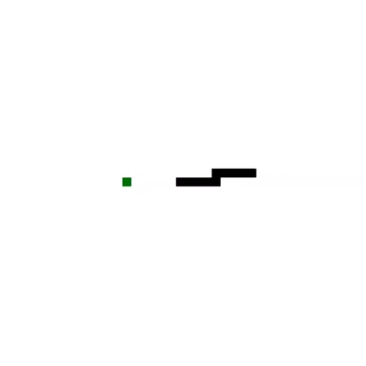
Game 2: Snake
Game Setup:
Utilizes the turtle library for drawing, freegames library for basic vector and drawing functions, and pygame library for audio feedback.
Features a snake that grows when eating food, represented by a green square.
Game Objective:
The objective is to eat food that randomly appears, causing the snake to grow.
Game Flow:
Starts with the snake moving in a predefined direction.
The game ends if the snake runs into itself or the boundaries.
Interactivity:
Responds to arrow keys to change direction.
Provides visual feedback by changing the color of the collision point to red upon game over.
Notes:
Use of Python Libraries:
Turtle Module: Used for all game rendering—drawing the snake, food, and obstacles.
Random Module: Utilized to randomly place food and obstacles on the game grid.

Slide 11
Game 2: Original Demo

Slide 12
Game 2: Original Code
Core Functions:
move(): Advances the snake in the direction it's facing. If the snake's head collides with the boundaries or itself, the game ends with a red square indicating the collision point.
change(): Alters the snake's direction based on keyboard input (arrow keys).
inside(): Checks if the snake’s head is within the play area boundaries.
Notes:
Code Structure:
Similar to Simon, the Snake game also operates within a main loop facilitated by the ontimer() function from the Turtle module, which periodically calls the move() function to update the game state.

Slide 13
Game 2: Changes
Enhancements:
Obstacles: Introduces obstacles (brown squares) that the snake must avoid, adding complexity to the game.
Scoring System: Implements a scoring system where the player earns points for each food item consumed.
New Components:
score_writer: A Turtle object dedicated to displaying the score on the screen, enhancing player feedback.
display_score(): Updates and shows the score on the game screen.
Notes:
Enhancements in the Modified Version:
Obstacles: The addition of randomly placed obstacles that the snake must avoid, increasing game difficulty.
Scoring System: Scores increase by a fixed amount each time the snake eats food. The score is displayed using the Turtle object, which is updated every time the score changes.

Slide 14
Game 2: Changes (Cont.)
Modified Mechanics:
move(): Now checks for collisions not only with the boundaries and the snake itself but also with new obstacles. Ends the game and prints the final score if a collision occurs.
Enhances the reward system by increasing the player's score with each food item consumed.
Visual and Gameplay Changes:
Each element (snake, food, obstacles) is distinctly colored (black for the snake, green for food, and brown for obstacles).
The score is dynamically updated and displayed, providing continuous feedback on the player's performance.

Slide 15
Game 2: Modified Demo

Slide 16
Thank You!

